Slide 1
Brain Computer Interaction
Feature Translation
Course Instructors
Dr. Sreeja S R
Assistant Professor
Indian Institute of Information Technology
IIIT Sri City

Slide 2
Illustrating Classification Tasks

Slide 3
Classification Techniques
Classification consists of assigning a class label to a set of unclassified cases.
Supervised Classification
The set of possible classes is known in advance.
Unsupervised Classification
Set of possible classes is not known. After classification we can try to assign a name to that class.
Unsupervised classification is called clustering.

Slide 4
Supervised Classification
Source: https://www.g2.com/articles/supervised-vs-unsupervised-learning

Slide 5
Unsupervised Classification

Slide 6
Supervised Classification Technique
Given a collection of records (training set )
Each record contains a set of attributes, one of the attributes is the class.
Find a model for class attribute as a function of the values of other attributes.
Goal: Previously unseen records should be assigned a class as accurately as possible.
Satisfy the property of “mutually exclusive and exhaustive”

Slide 7
Regression Analysis
The regression analysis is a statistical method to deal with the formulation of mathematical model depicting relationship amongst variables, which can be used for the purpose of prediction of the values of dependent variable, given the values of independent variables.
Classification of Regression Analysis Models
Linear regression models
Simple linear regression
Multiple linear regression
Non-linear regression models

Slide 8
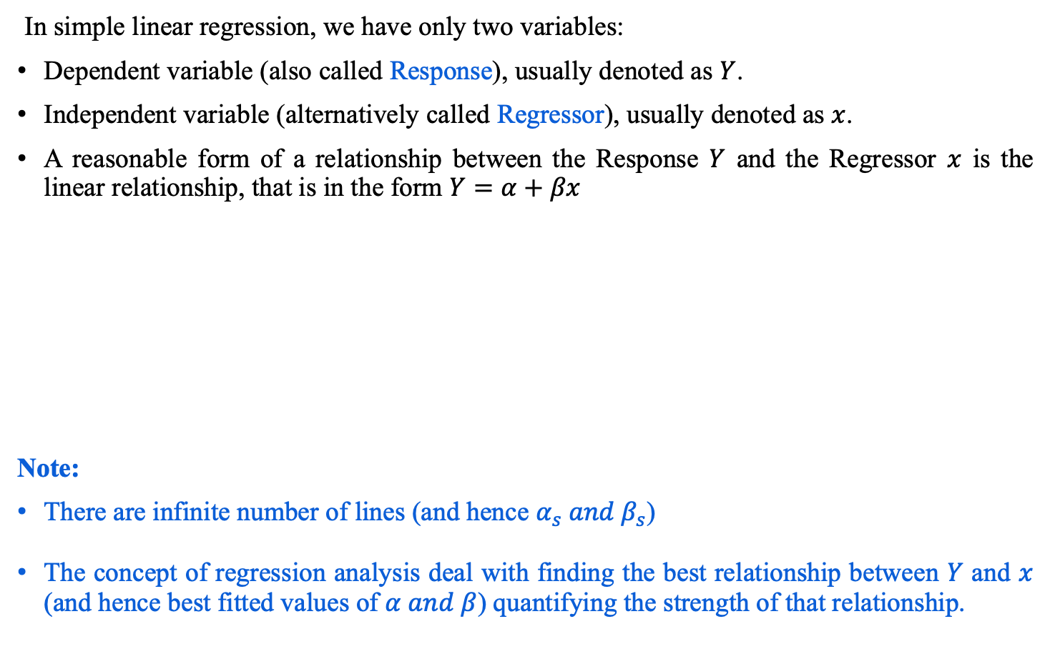
Simple Linear Regression Model
In simple linear regression, we have only two variables:
Dependent variable (also called Response), usually denoted as $Y$.
Independent variable (alternatively called Regressor), usually denoted as $x$.
A reasonable form of a relationship between the Response $Y$ and the Regressor $x$ is the linear relationship, that is in the form $Y=α+βx$
Note:
There are infinite number of lines (and hence $α_{s} and β_{s}$)
The concept of regression analysis deal with finding the best relationship between $Y$ and $x$ (and hence best fitted values of $α and β$) quantifying the strength of that relationship.

Slide 9
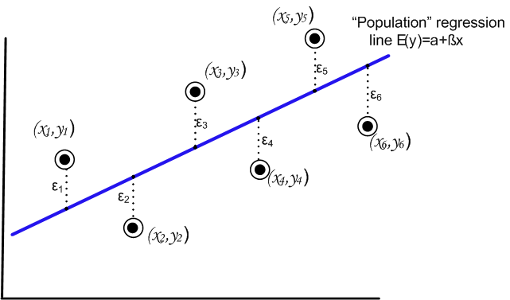
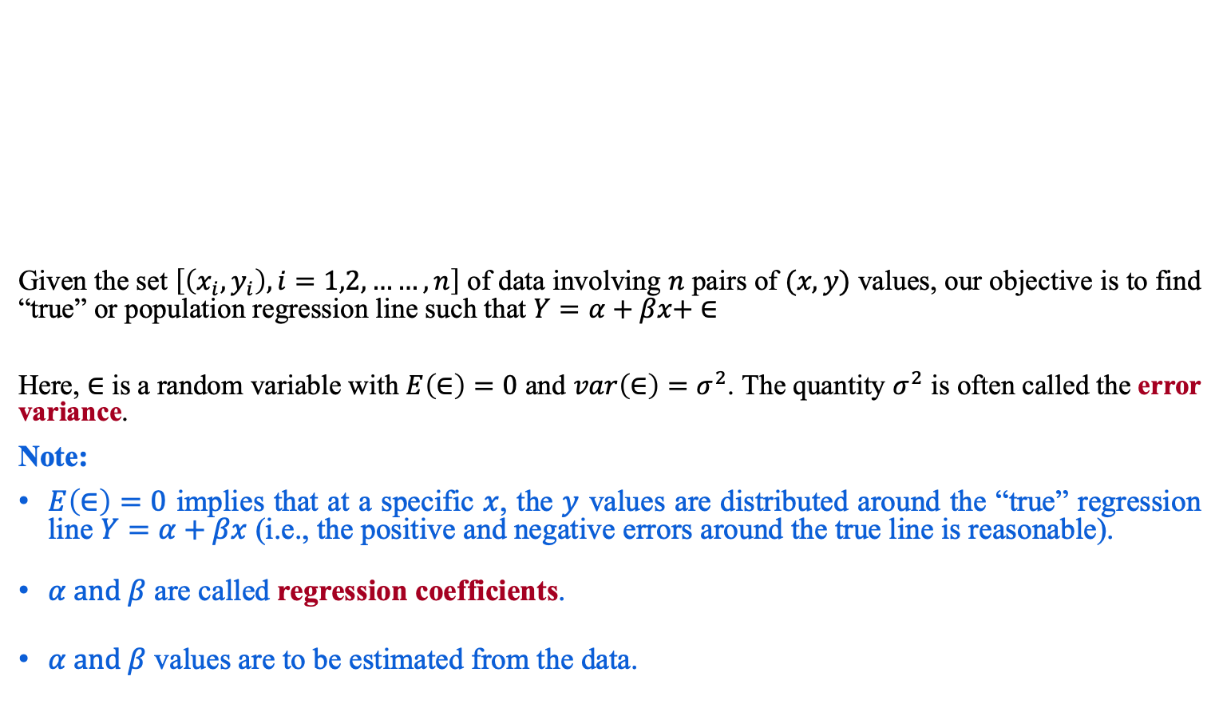
Regression Analysis
Given the set $\left[\left(x_{i},y_{i}\right), i=1,2,……,n\right]$ of data involving $n$ pairs of $(x,y)$ values, our objective is to find “true” or population regression line such that $Y=α+βx+ ∈$
Here, $∈$ is a random variable with $E\left(∈\right)=0$ and $var\left(∈\right)=σ^{2}$. The quantity $σ^{2}$ is often called the error variance.
Note:
$E\left(∈\right)=0$ implies that at a specific $x$, the $y$ values are distributed around the “true” regression line $Y=α+βx$ (i.e., the positive and negative errors around the true line is reasonable).
$α and β$ are called regression coefficients.
$α and β$ values are to be estimated from the data.

Slide 10
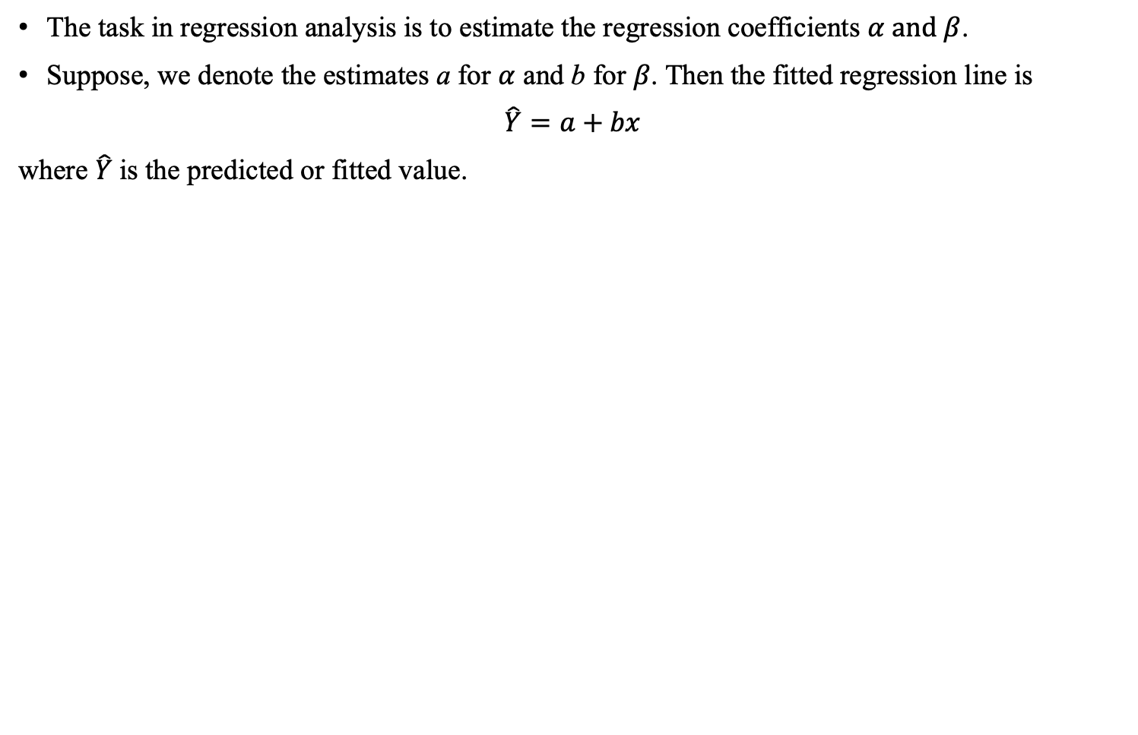
True versus Fitted Regression Line
The task in regression analysis is to estimate the regression coefficients $α and β$.
Suppose, we denote the estimates a for $α$ and b for $β$. Then the fitted regression line is
$\hat{Y}=a+bx$
where $\hat{Y}$is the predicted or fitted value.

Slide 11
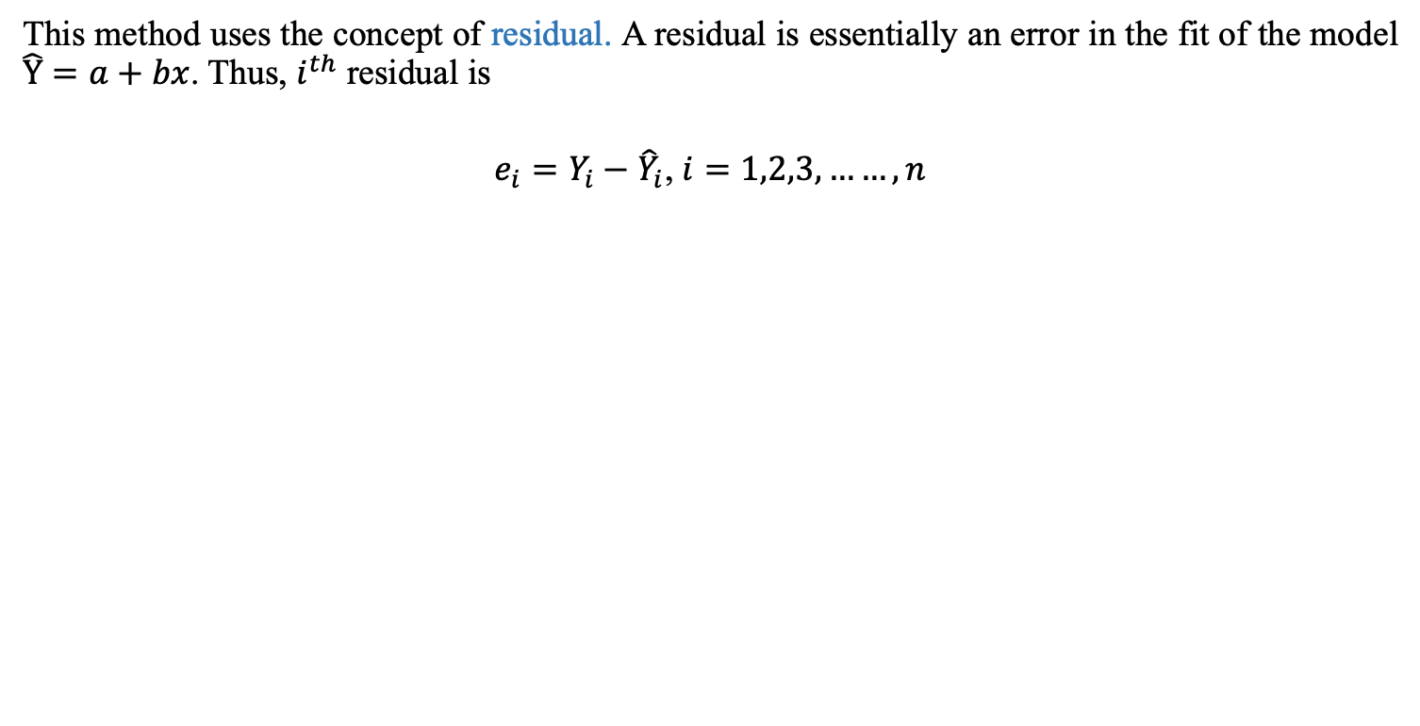
Least Square Method to estimate $α and β$
This method uses the concept of residual. A residual is essentially an error in the fit of the model $\hat{Y}=a+bx$. Thus, $i^{th}$ residual is
$e_{i}=Y_{i}−{\hat{Y}}_{i}$, $i=1,2,3,……,n$

Slide 12
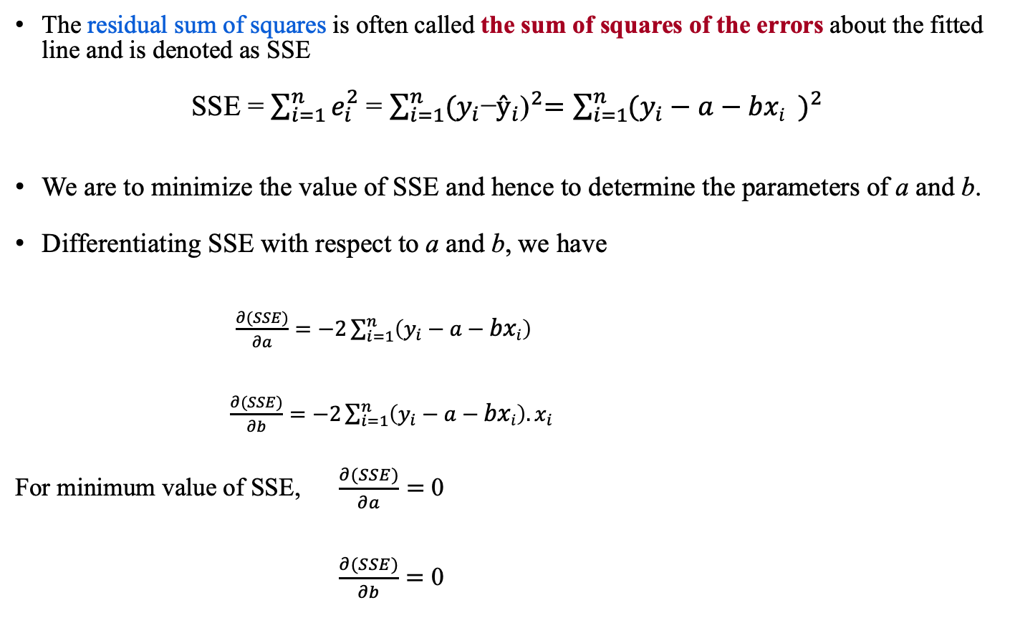
Least Square method
The residual sum of squares is often called the sum of squares of the errors about the fitted line and is denoted as SSE
SSE = $\sum_{i=1}^{n}{e_{i}^{2}}$ = $\sum_{i=1}^{n}{{(y_{i}\text{−}ŷ_{i}\text{)}}^{2}=\sum_{i=1}^{n}{{(y_{i}−a−{bxi}_{})}^{2}}}$
We are to minimize the value of SSE and hence to determine the parameters of a and b.
Differentiating SSE with respect to a and b, we have
$\frac{∂(SSE)}{∂a}=−2\sum_{i=1}^{n}{{\left(y_{i}−a−bxi\right)}^{}}$
$\frac{∂(SSE)}{∂b}=−2\sum_{i=1}^{n}{\left(y_{i}−a−bxi\right).x_{i}}$
For minimum value of SSE, $\frac{∂(SSE)}{∂a}=$ 0
$\frac{∂(SSE)}{∂b}=$ 0

Slide 13
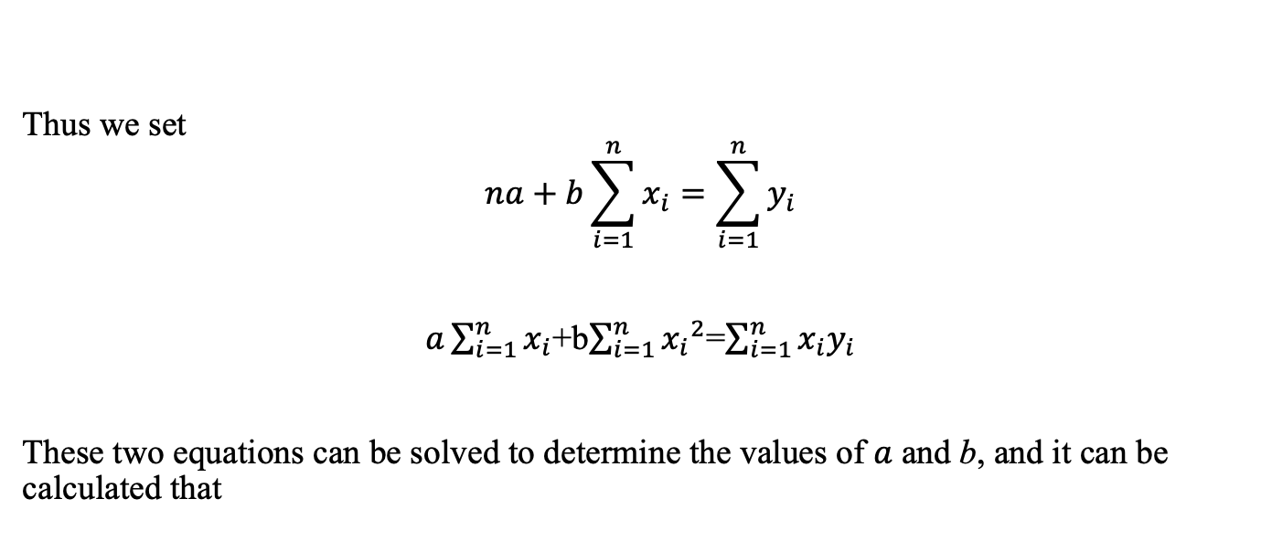
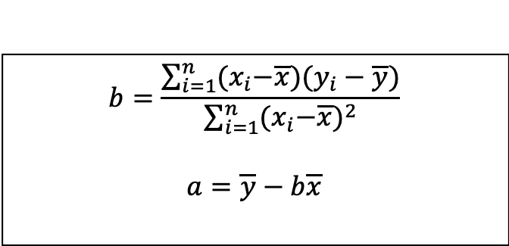
Least Square method to estimate $α and β$
Thus we set
$$na+b\sum_{i=1}^{n}{x_{i}}=\sum_{i=1}^{n}{y_{i}}$$
$a\sum_{i=1}^{n}{x_{i}}$+b$\sum_{i=1}^{n}{{x_{i}}^{2}}$=$\sum_{i=1}^{n}{x_{i}y_{i}}$
These two equations can be solved to determine the values of $a$ and b, and it can be calculated that
$$b=\frac{\sum_{i=1}^{n}{{(x}_{i}−\overline{x}{)(y}_{i}−\overline{y})}}{\sum_{i=1}^{n}{{{(x}_{i}−\overline{x})}^{2}}}$$
$$a=\overline{y}−b\overline{x}$$

Slide 14
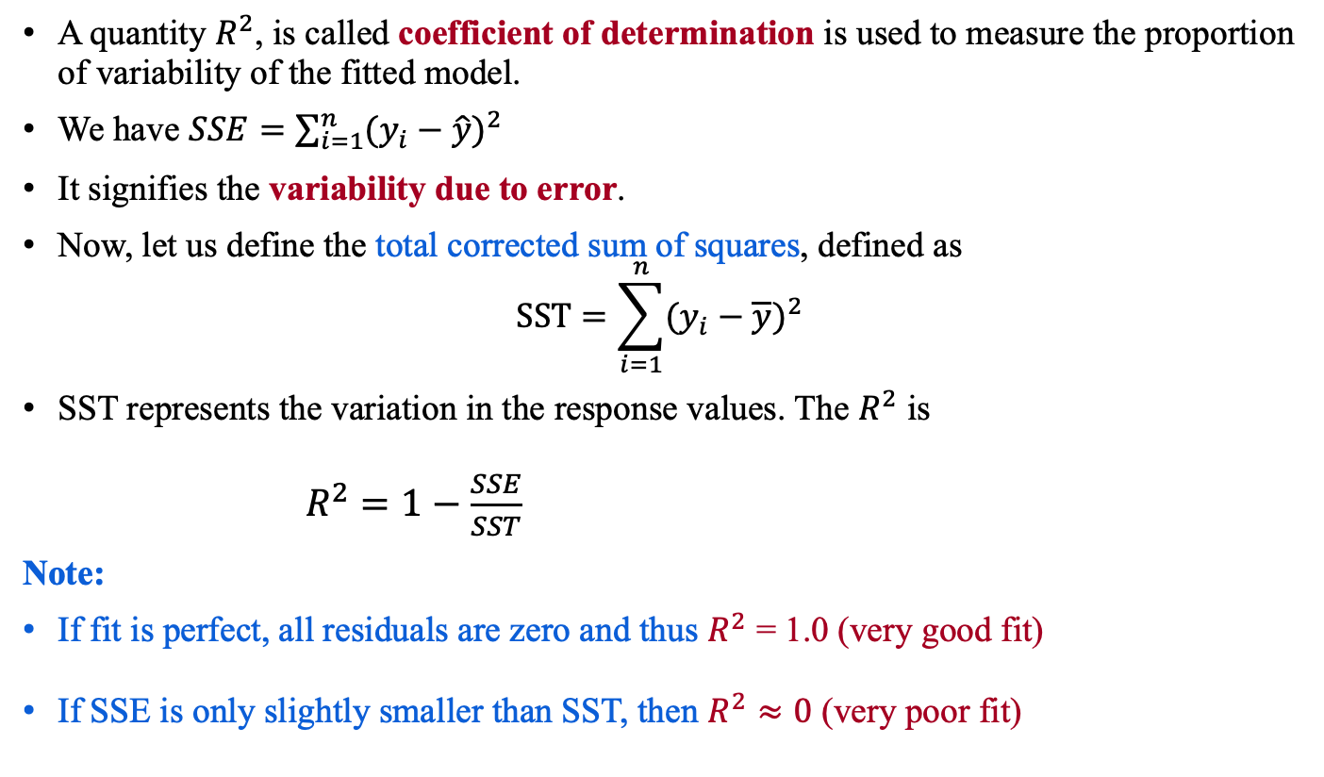
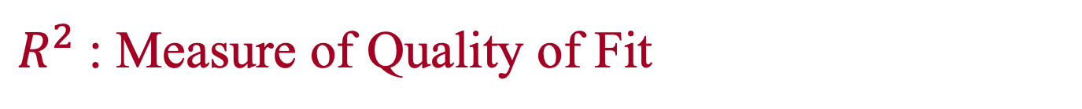
$R^{2}$: Measure of Quality of Fit
A quantity $R^{2}$, is called coefficient of determination is used to measure the proportion of variability of the fitted model.
We have $SSE=\sum_{i=1}^{n}{{(y_{i}−\hat{y})}^{2}}$
It signifies the variability due to error.
Now, let us define the total corrected sum of squares, defined as
$$SST=\sum_{i=1}^{n}{{(y_{i}−\overline{y})}^{2}}$$
SST represents the variation in the response values. The $R^{2}$ is
$R^{2}=1−\frac{SSE}{SST}$
Note:
If fit is perfect, all residuals are zero and thus $R^{2}$ = 1.0 (very good fit)
If SSE is only slightly smaller than SST, then $R^{2}≈0$ (very poor fit)

Slide 15
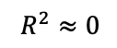
$R^{2}$: Measure of Quality of Fit
$$R^{2}≈0$$

Slide 16
Any question?

Slide 17
Thank You!

